Slide 1


COVID ERA CRIMES IN SF
Team ACY
Link to Power BI Dashboard
Last data refresh:
4/20/2021 6:14:57 PM UTC
Downloaded at:
4/20/2021 6:23:21 PM UTC

Slide 2
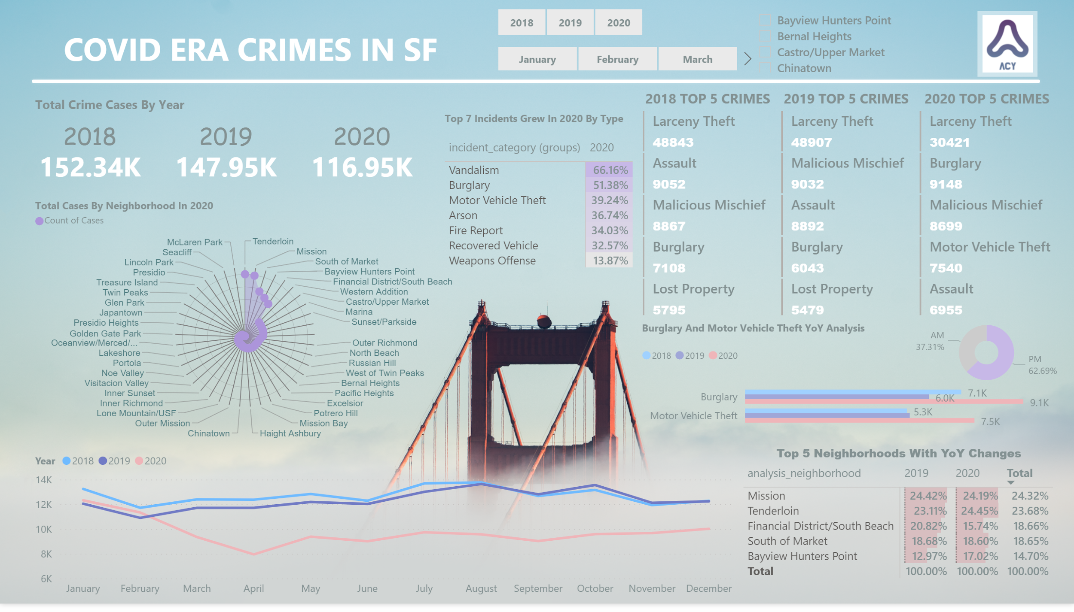
Notes:
shape
No alt text provided.
textbox
No alt text provided.
image
No alt text provided.
2020
No alt text provided.
2019
No alt text provided.
2018
No alt text provided.
lineChart
No alt text provided.
slicer
No alt text provided.
2018 TOP 5 CRIMES
No alt text provided.
2020 TOP 5 CRIMES
No alt text provided.
2019 TOP 5 CRIMES
No alt text provided.
Top 5 Neighborhoods With YoY Changes
No alt text provided.
textbox
No alt text provided.
slicer
No alt text provided.
donutChart
No alt text provided.
clusteredBarChart
No alt text provided.
textbox
No alt text provided.
Count of Cases by Neighborhood For 2020
No alt text provided.
textbox
No alt text provided.
slicer
No alt text provided.
pivotTable
No alt text provided.
textbox
No alt text provided.

Slide 3



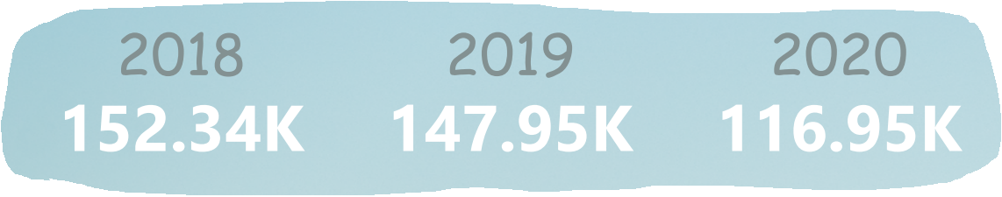
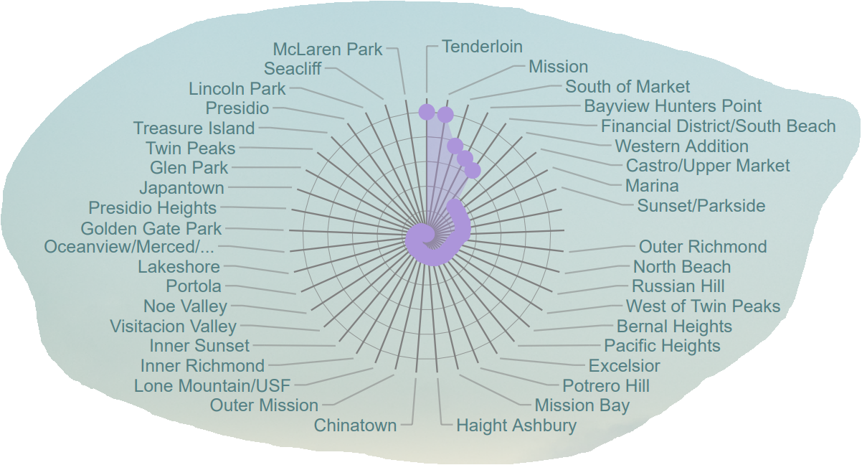
Some Numbers
Crime rate of year 2020 has decreased 21% comparing to 2019.
Total incident cases by neighborhood in 2020, Tenderloin and Mission are taking the lead.

Slide 4
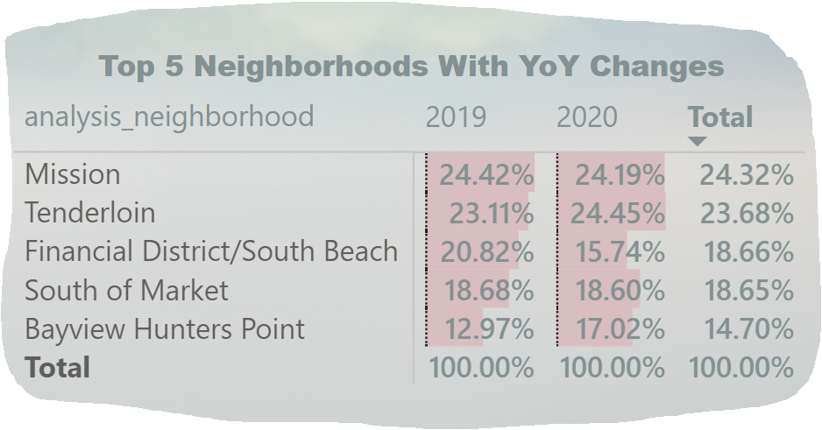
Question
Have COVID-19 changed how crime distributed in 2020?
The answer is YES.
Crime rate of Financial District/South Beach had nearly 5% decrease compared to 2019. As people started working from home, Financial District/South Beach has became less crowded, less trouble had occurred.

Slide 5
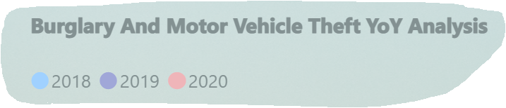
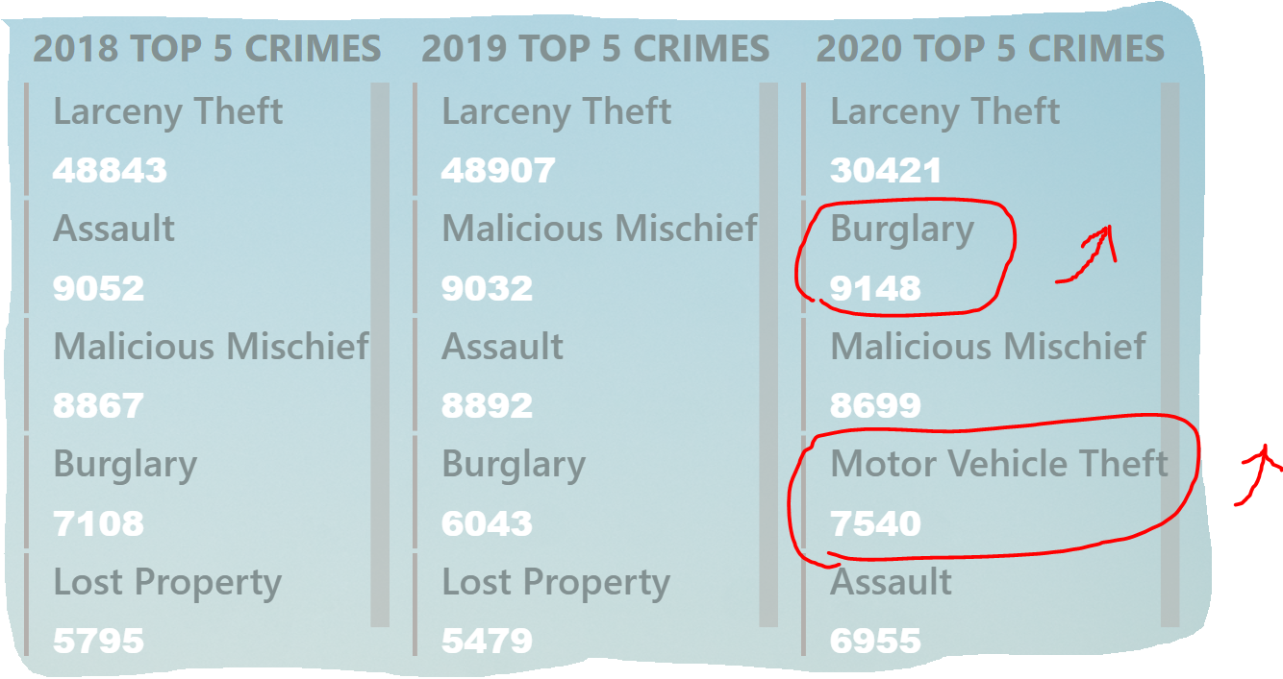

Have crime types changed?
The answer is YES.
Burglary had gone up approximately 3000 cases comparing to 2019, and Motor Vehicle Theft had became one of the top 5 crimes in 2020.

Slide 6
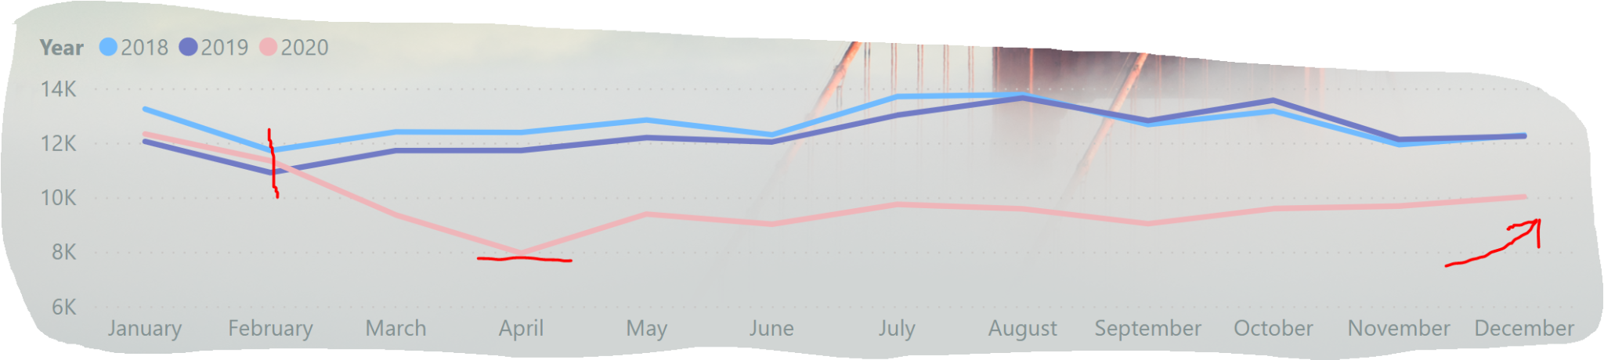
Crime trend throughout 2020
At the beginning of 2020, the trend was tied to 2018 and 2019, but it decreased rapidly after February due to pandemic, it has maintained at lower number of cases until the end of the year.
The reason the number was low might be because of the restrictions on businesses and outdoor activities.

Slide 7



